Slide 1
Introduction to Algorithms
Novario Jaya Perdana

Slide 2
Introduction to Algorithm
Tools:
JDK 20
Apache Netbeans 15
ilearning.oracle.com

Slide 3
Susunan Materi
RPS:
Overview of Java
Java Fundamentals: data types, operators, array, control statements
Classes and Methods
Inheritance, Polymorphs, Interface
Exception Handling

Slide 4
Perkuliahan
Lectures:
Instructor: Novario Jaya Perdana, MT.
Text Book:
Timothy A. Budd, An Introduction to Object-Oriented Programming (3rd Ed.), 2002, Wesley
Herbert Schildt, JavaTM The Complete Reference (12th Ed), 2022, Wiley

Slide 5
Pemrograman Berorientasi Object
OOP has been the dominant programming paradigm for more than twenty years. Why is it so popular?
Proven record of success.
Scales well from small problems to large
Resonant similarity to techniques for thinking about problems in other domains.
Nevertheless, programming is still a task that requires skill and learning.

Slide 6
Contoh
A student working in DNA research had the task of finding repeated sequences of M values in a long sequence of values:
ACTCGGATCTTGCATTTCGGCAATTGGACCCTGACTTGGCCA ...

Slide 7
Contoh
A C T C G G positions 1 to M
C T C G G A positions 2 to M+1
T C G G A T positions 3 to M+2
C G G A T T positions 4 to M+3
G G A T T C positions 5 to M+4
G A T T C T positions 6 to M+5
. . .
T G G A C C
G G A C C C . . .
DO 10 I = 1, N-M
DO 10 J = I+1, N-M
FOUND = .TRUE.
DO 20 K = 1, M
20 IF X[I+K-1] .NE. X[J+K-1] THEN FOUND = .FALSE.
IF FOUND THEN ...
10 CONTINUE

Slide 8
What lead to the discovery?
The better solution:
Fortran programmer was blinded by a culture that valued loops, simple programs
Sorting is a built-in operation in APL, good programmers try to find novel uses for sorting
The fundamental point is that the language you speak leads you in one direction or another.

Slide 9
Imperative Programming
So, what are the paradigms of programming?
Imperative programming is the ``traditional'' model of computation.
State
Variables
Assignment
Loops
A processing unit is separate from memory, and ``acts'' upon memory.

Slide 10
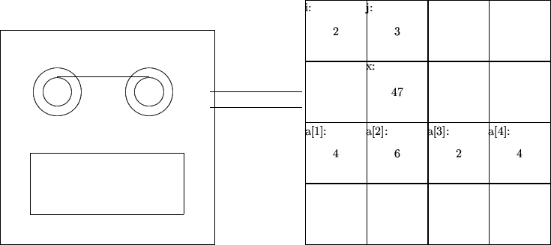
Visualization of Imperative Programming

Slide 11
Why Not Build a Program out of Computers?
Alan Kay thought about this conventional design of the computer, and asked why we constructed the whole out of pieces that were useless by themselves.
Why not build a whole out of pieces that were similar at all levels of detail? (Think of fractals).
Idea: A program can be build out of little computing agents.

Slide 12
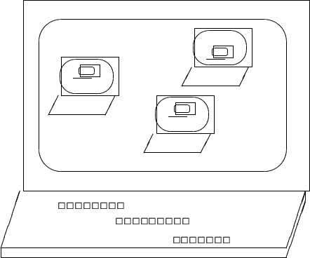
Recursive Design
The structure of the part mirrors the structure of the larger unit.

Slide 13
Kay's Description of Object-Oriented Programming
Object-oriented programming is based on the priciple of recursive design.
Everything is an object
Objects perform computation by making requests of each other through the passing of messages
Every object has it's own memory, which consists of other objects.
Every object is an instance of a class. A class groups similar objects.
The class is the repository for behavior associated with an object
Classes are organized into singly-rooted tree structure, called an inheritance hierarchy.

Slide 14
Illustration of OOP Concepts Sending Flowers to a Friend
To illustrate the concepts of OOP in an easily understood framework, consider the problem of sending flowers to a friend who lives in a different city. Chris is sending flowers to Robin.
Chris can't deliver them directly. So Chris uses the services of the local Florist.
Chris tells the Florist (named Fred) the address for Robin, how much to spend, and the type of flowers to send.
Fred contacts a florist in Robins city, who arranges the flowers, then contacts a driver, who delivers the flowers.
If we start to think about it, there may even be other people involved in this transaction. There is the flower grower, perhaps somebody in charge of arrangements, and so on.

Slide 15
Agents and Communities
Our first observation is that results are achieved through the interaction of agents, which we will call objects.
Furthermore, any nontrivial activity requires the interaction of an entire community of objects working together.

Slide 16
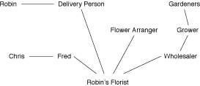
Agents and Communities
Each object has a part to play, a service they provide to the other members of the community.

Slide 17
Elements of OOP - Objects
Everything is an object
Actions in OOP are performed by agents, called instances or objects.
There are many agents working together in my scenario. We have Chris, Robin, the florist, the florist in Robins city, the driver, the flower arranger, and the grower. Each agent has a part to play, and the result is produced when all work together in the solution of a problem.

Slide 18
Elements of OOP - Messages
Objects perform computation by making requests of each other through the passing of messages
Actions in OOP are produced in response to requests for actions, called messges. An instance may accept a message, and in return will perform an action and return a value.
To begin the process of sending the flowers, Chris gives a message to Fred. Fred in turn gives a message to the florist in Robins city, who gives another message to the driver, and so on.

Slide 19
Elements of OOP – Information Hiding
As a user of a service being provided by an object, we need only know the name of the messages that the object will accept.
We need not have any idea how the actions performed in response to the request will be carried out.
Having accepted a message, an object is responsible for carrying it out.

Slide 20
Elements of OOP – Receivers
Messages differ from traditional function calls in two very important respects:
In a message there is a designated receiver that accepts the message
The interpretation of the message may be different, depending upon the receiver

Slide 21
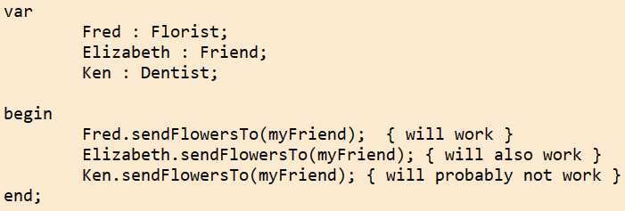
Elements of OOP – Receivers

Slide 22
Behavior and Interpretation
Although different objects may accept the same message, the actions (behavior) the object will perform will likely be different.
The determination of what behavior to perform may be made at run-time, a form of late binding.
The fact that the same name can mean two entirely different operations is one form of polymorphism.

Slide 23
Elements of OOP - Recursive Design
Every object has its own memory, which consists of other objects
Each object is like a miniature computer itself - a specialized processor performing a specific task.

Slide 24
Elements of OOP - Classes
Every object is an instance of a class. A class groups similar objects.
The class is the repository for behavior associated with an object.
The behavior expected from Fred is determined from a general idea of the behavior of Florists.
We say Fred is an instance of the class Florist.
Behavior is associated with classes, not with individual instances. All objects that are instances of a class use the same method in response to similar messages.

Slide 25
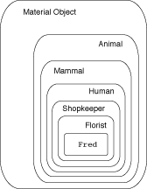
Hierarchies of Categories
But there is more that I know about Fred then just that he is a Florist. I know he is a ShopKeeper, and a Human, and a Mammal, and a Material Objects, and so on.
At each level of abstraction I have certain information recorded. That information is applicable to all lower (more specialized) levels.

Slide 26
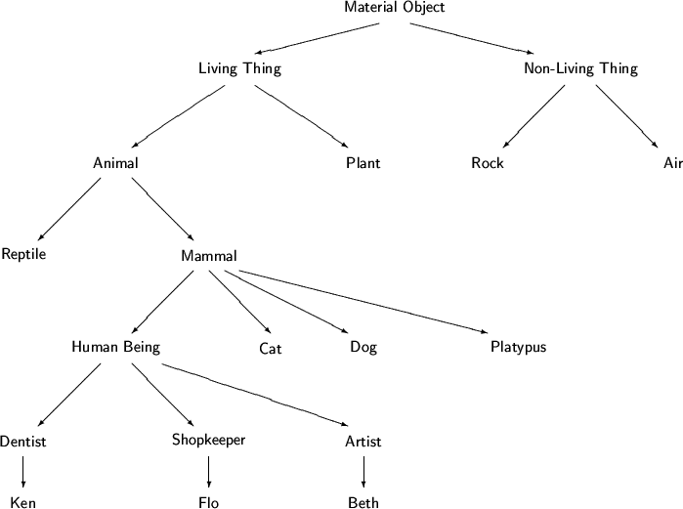
Class Hierarchies

Slide 27
Elements of OOP - Inheritance
Classes are organized into a singly-rooted tree structure, called an inheritance hierarchy
Information (data and/or behavior) I associate with one level of abstraction in a class hierarchy is automatically applicable to lower levels of the hierarchy.

Slide 28
Elements of OOP - Overriding
Subclasses can alter or override information inherited from parent classes:
All mammals give birth to live young
A platypus is an egg-laying mammal
Inheritance combined with overriding are where most of the power of OO originates.

Slide 29
Summary
Object-oriented programming is not simply features added to a programming language. Rather, it is a new way of thinking
Object-oriented programming views a program as a community of agents, termed objects. Each object is responsible for a specific task.
An object is an encapsulation of state (data values) and behavior (operations).
The behavior of objects is dictated by the object class.
An object will exhibit its behavior by invoking a method (similar to executing a procedure) in response to a message.
Objects and classes extend the concept of abstract data types by adding the notion of inheritance.

Slide 30
Tugas
Berikan contoh struktur hirarki yang ada di kehidupan sehari-hari yang menganut konsep inheritance, dan contoh struktur hirarki yang tidak menganut konsep inheritance.
Ambil satu contoh permasalahan di kehidupan sehari-hari dan deskripsikan solusinya dalam bentuk object dan responsibilities nya.

